Slide 1
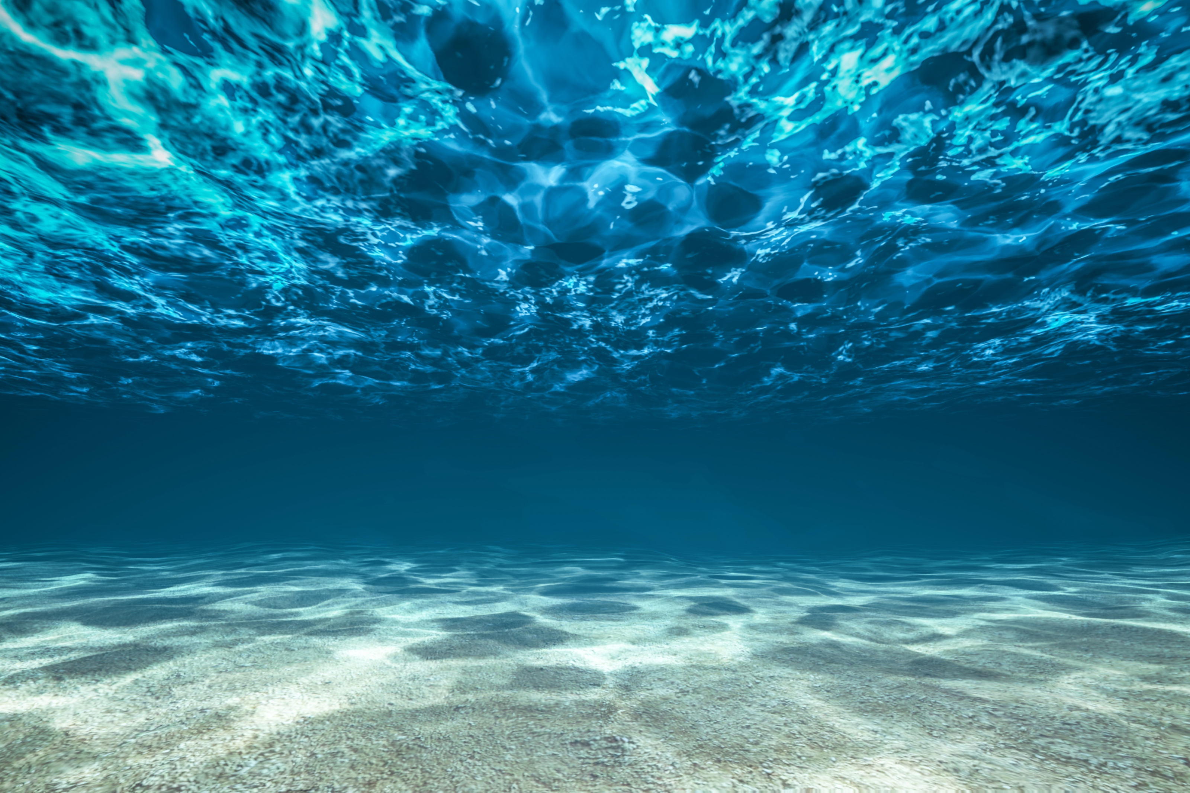
Testbed for IoUT
Felipe Bahamondes, Mathias Markvardsen, Morten Henriksen

Slide 2
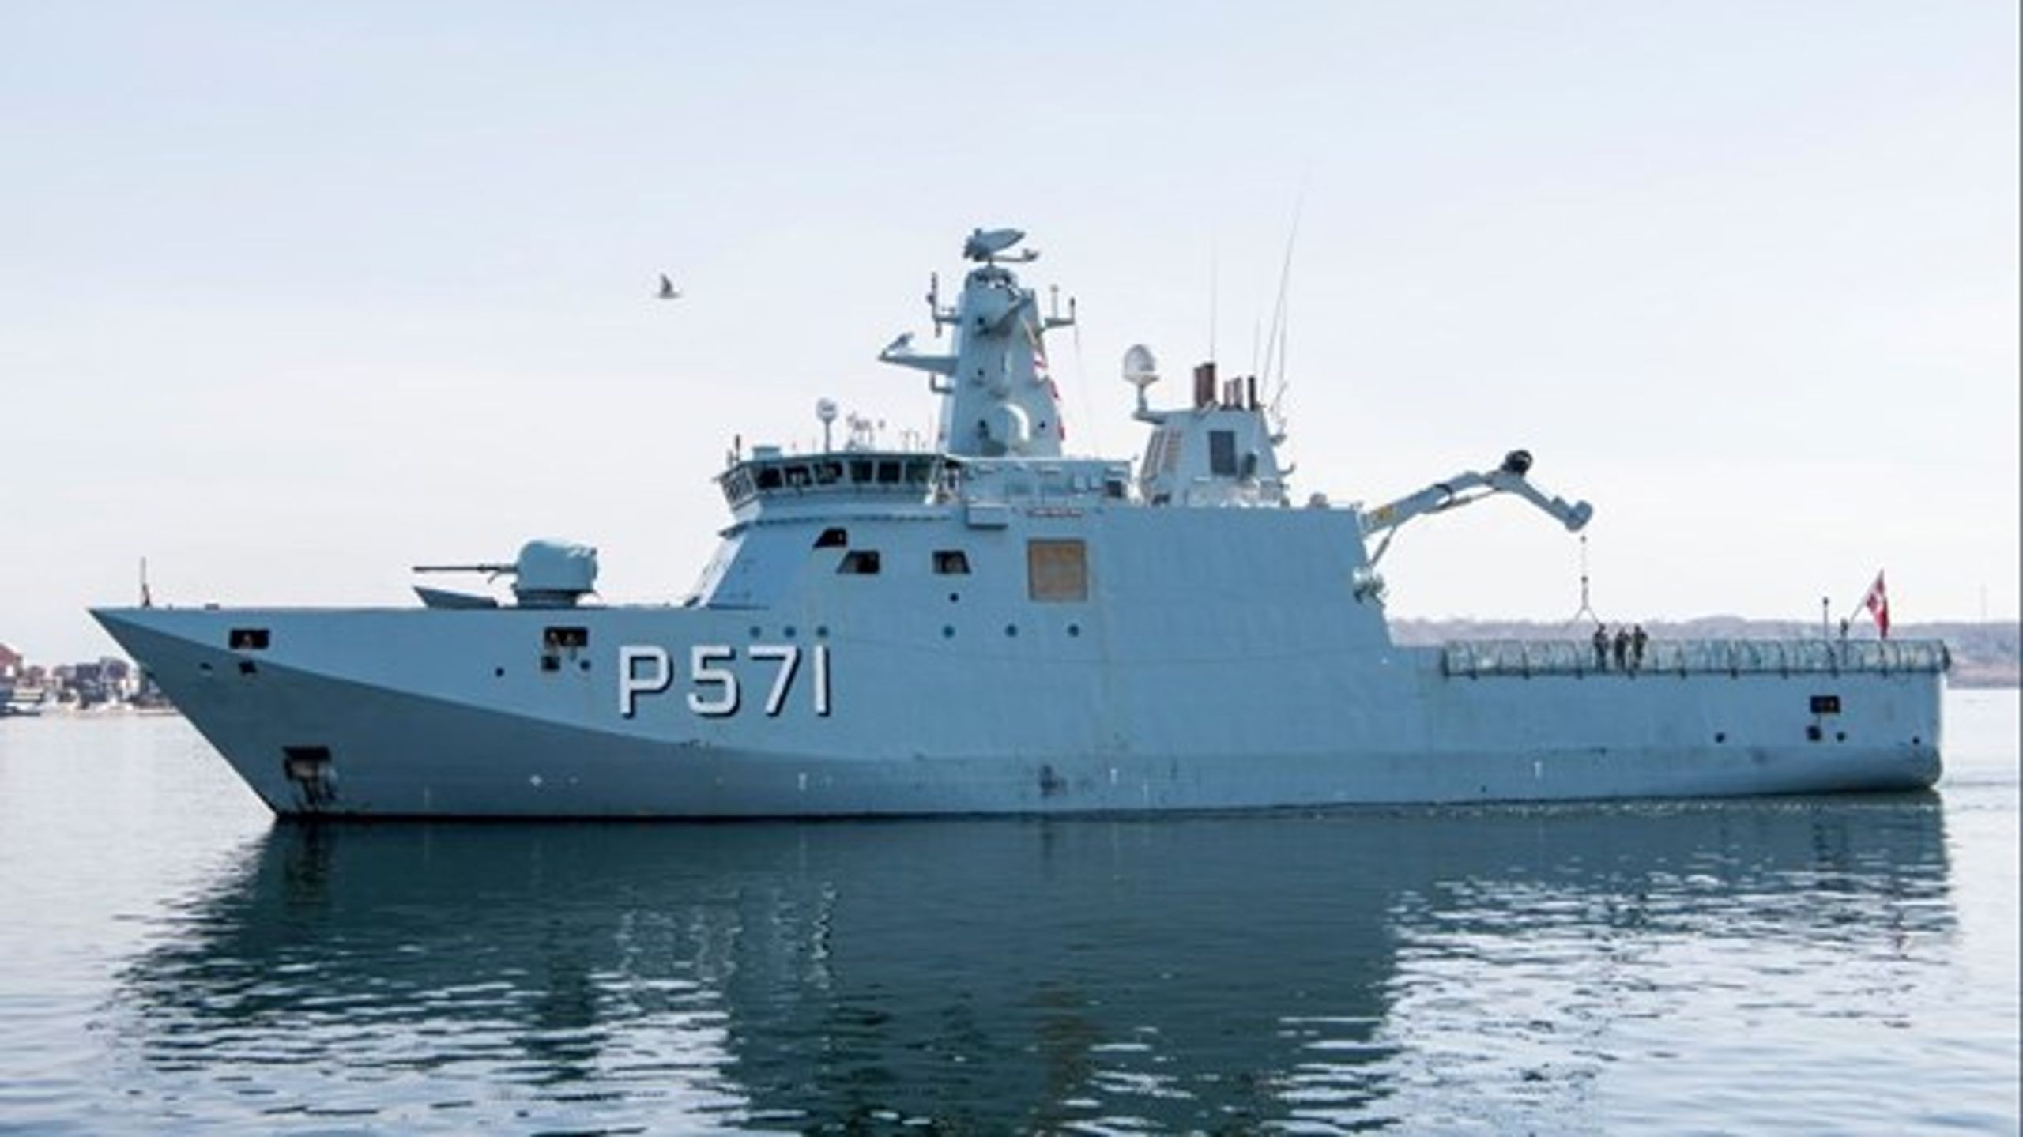
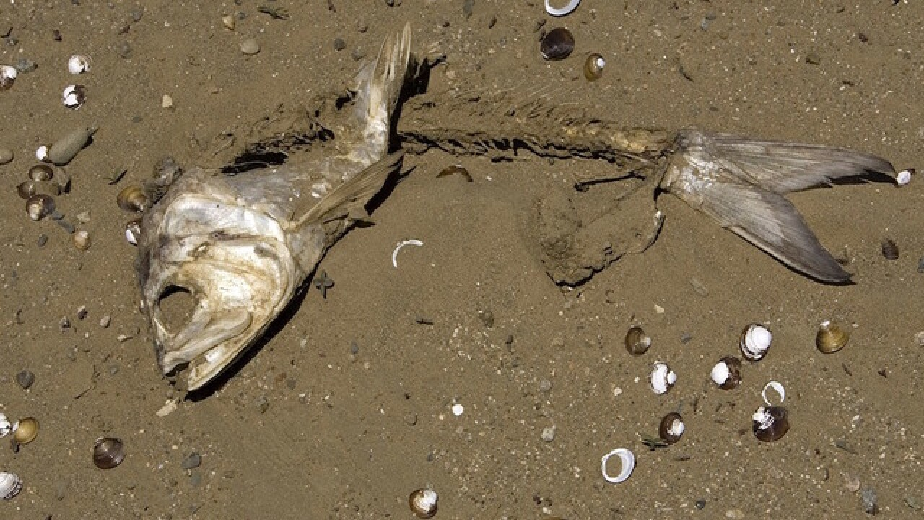
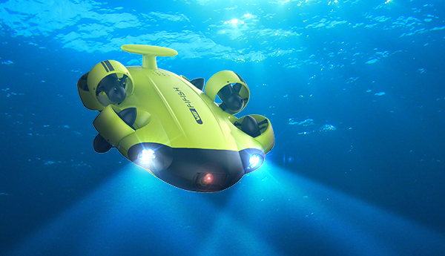
Motivation
To facilitate a test bed that will act as reference frame for researchers to compare their innovations

Slide 3
Story line
1. Intro & motivation – what are we doing, who are we
2. Play .wav file of funny msg
3. Explain how that message was made – carirer, modulation, dsp, encoding? Figures, plots

Slide 4
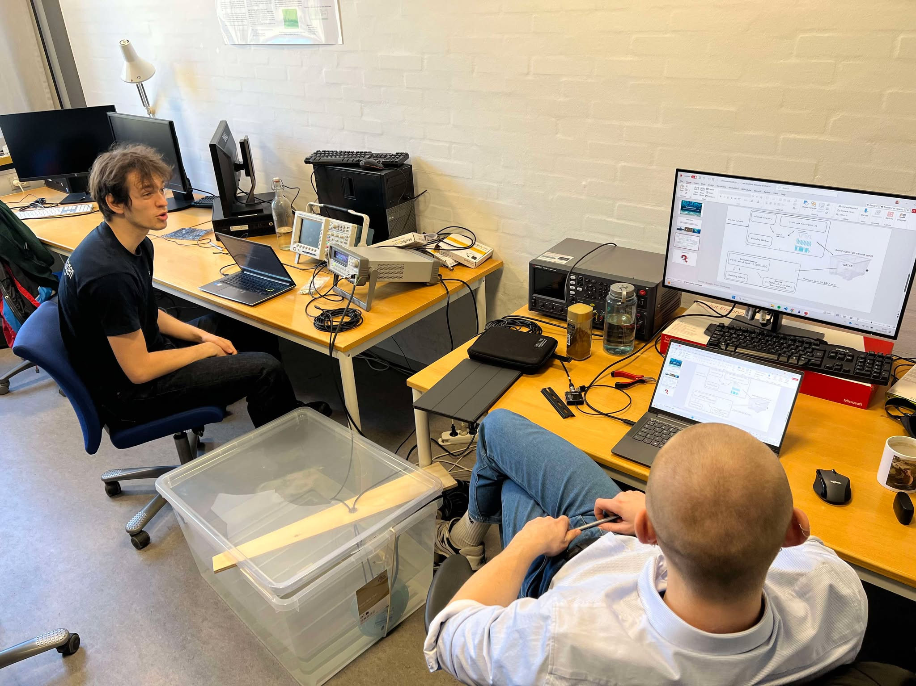

Questions?

